Slide 1

Image Classification in Deep Learning
CUNY 698 – MS in Data Science
Walt Wells – Spring 2018

Slide 2
IntroDuction
Deep learning techniques are one of the most exciting and effective new approaches to building a machine learning system that can operate with accuracy and precision in a complex real-world environment. This is important because for difficult problems with highly dimensional data like image classification, deep learning models like Artificial Neural Networks (ANNs), Convolutional Neural Networks (CNNs) and Deep Neural Networks (DNNs) are among the best performers in benchmarked competitions and are even outpacing their human subject matter expert counterparts at image classification tasks.
But how do they work?
This study will seek to explore a variety of deep learning techniques by building a convolutional neural network and conducting image classification over a popular benchmarking dataset.

Slide 3
Literature Review

Slide 4
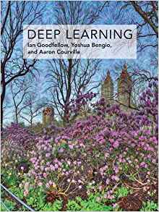
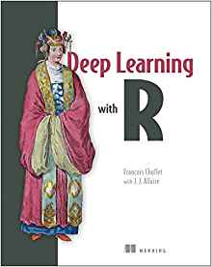
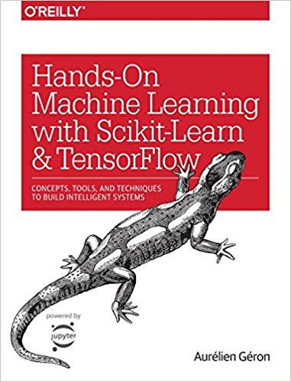
Deep Learning Survey
Overview of Deep Learning Techniques
How to Build, Train, and Test Models in Python and R
Computational Architecture and Data Engineering

Slide 5
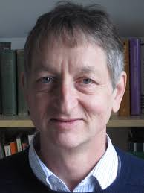

Image Classification Using Deep Learning
State of the Field
Innovative Academic Papers
Major Touchstones
Geoffrey Hinton and Yann LeCunn

Slide 6
Materials and Methods

Slide 7
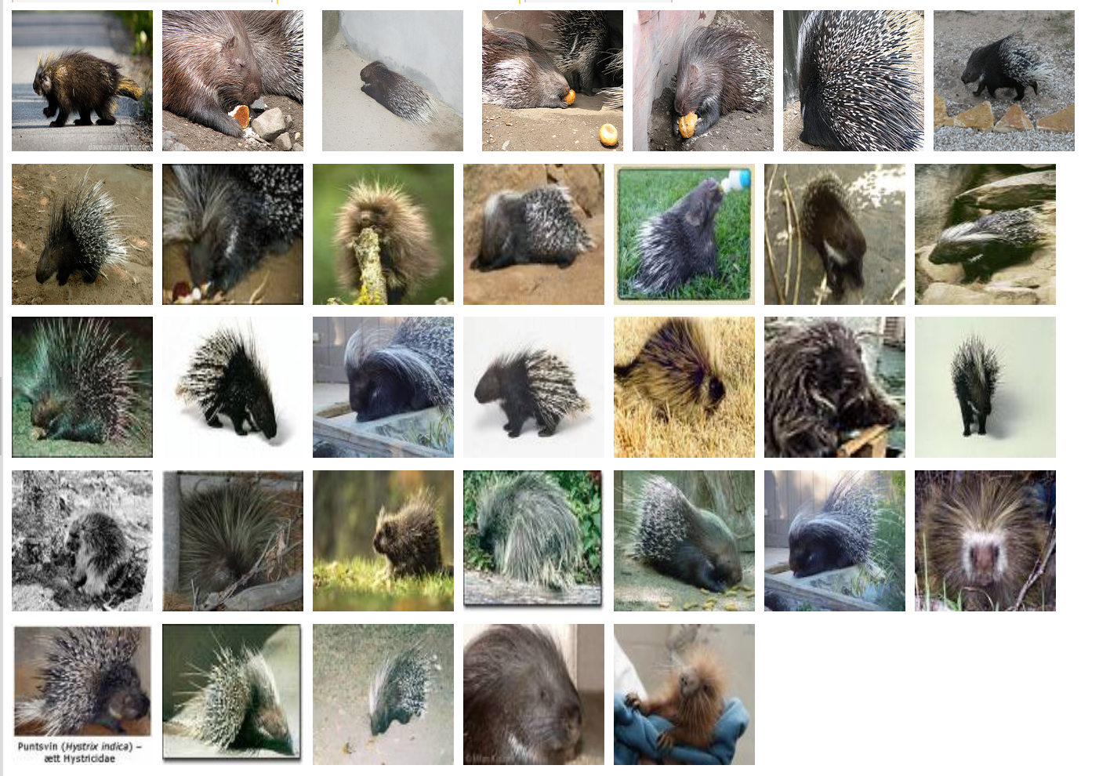
The Dataset
ImageNet and TinyImageNet
Stanford Vision Lab
Major Touchstone in Field of Computer Vision
1000 / 200 Labeled Classes
Split into Training and Validation Sets
~150 GiB / ~1 GiB

Slide 8
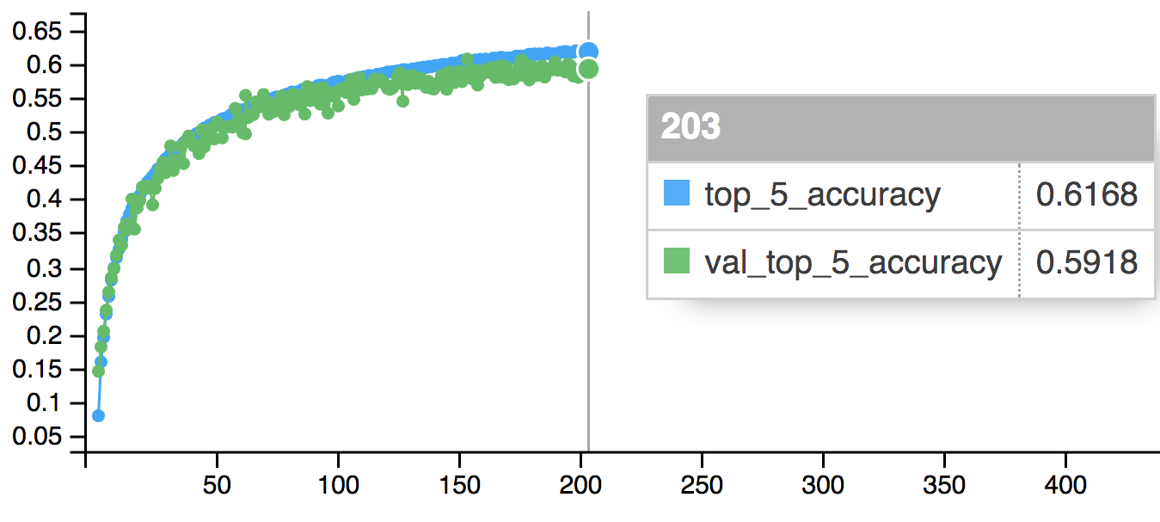
The Task
Build a model that, when given an image as input, will produce a list of 5 classes that it believes represent some aspect of the input image.
We will judge success and improve our model based on this ”top 5 accuracy” metric.
Since an image may contain multiple classes, (has a fish and a cat and a fork and a…) this method allows a model to identify multiple objects in an image and not be penalized if one of the objects identified was in fact present, but not included in the ground truth.

Slide 9




The Tools
We used relatively new tools and libraries in R (keras and cloudml) released or updated in 2018.
Keras with Tensorflow as the backend has excellent and intuitive functions for designing model architecture, training and optimizing models, data generation, data augmentation, and hyper parameter tuning.
The cloudml package provides a simple way to submit R Keras jobs to the Google ML Engine for training, testing, and prediction. Using this package abstracts away the need for a data scientist to manage and tune the hardware required for deep learning, making it as simple as sending a Keras script to the Google API.

Slide 10
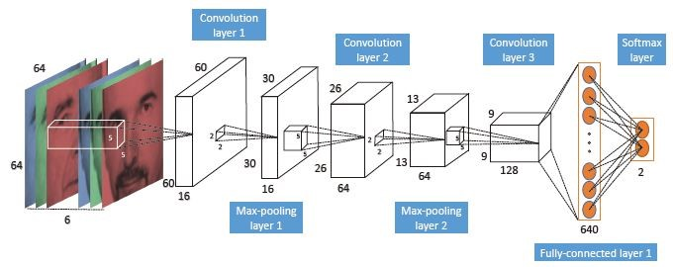
The Convolutional Neural Network
Convolutional neural networks are a feed-forward deep learning technique that excels at image classification tasks.
A feed-forward neural network is a series of interconnected layers that pass information forward from the input using a series of activation functions (relu, sigmoid, etc.).
The connections between layers are weights that determine the strength of the values passed forward from the previous layer.
Convolutions are a method extracting knowledge about a feature found in one part of an image (an eye, an ear), and being able to apply it to another image where the feature is in a different location.

Slide 11
Results

Slide 12
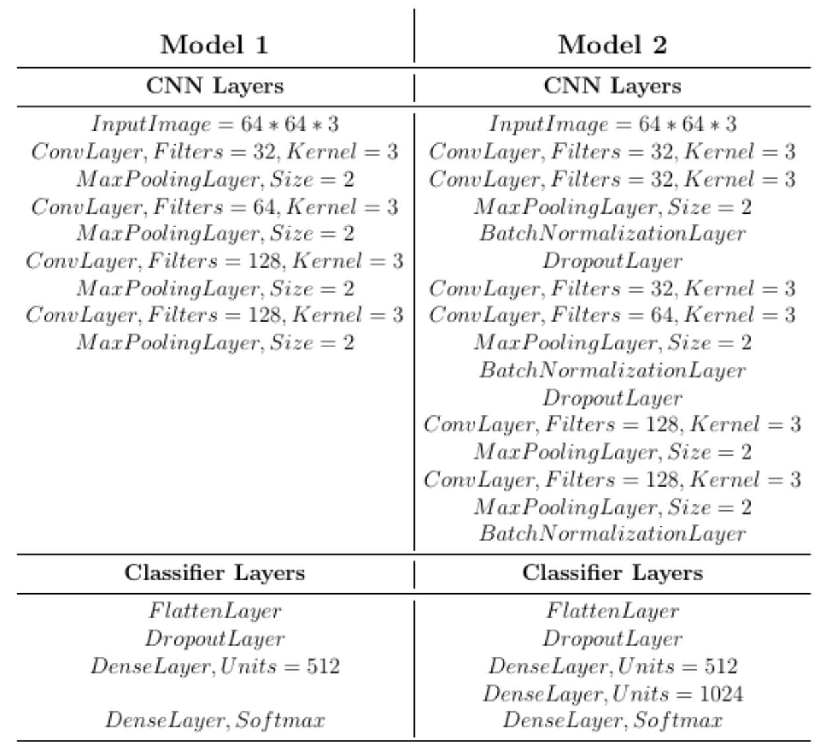
The Architecture
Two Different CNN Models were trained over the TinyImageNet Dataset; Roughly based on “AlexNet” architecture that did well in the 2012 ImageNet Challenge.
Model 1 is fairly simple, with a few different convolutional and pooling layers, increasing complexity slightly as it gets deeper.
Model 2 is a bit more complex, interspersing convolutional and pooling layers with batch normalizing and dropout layers.
At the end of each architecture we flatten our features and attach a classifer that predicts the classes.

Slide 13
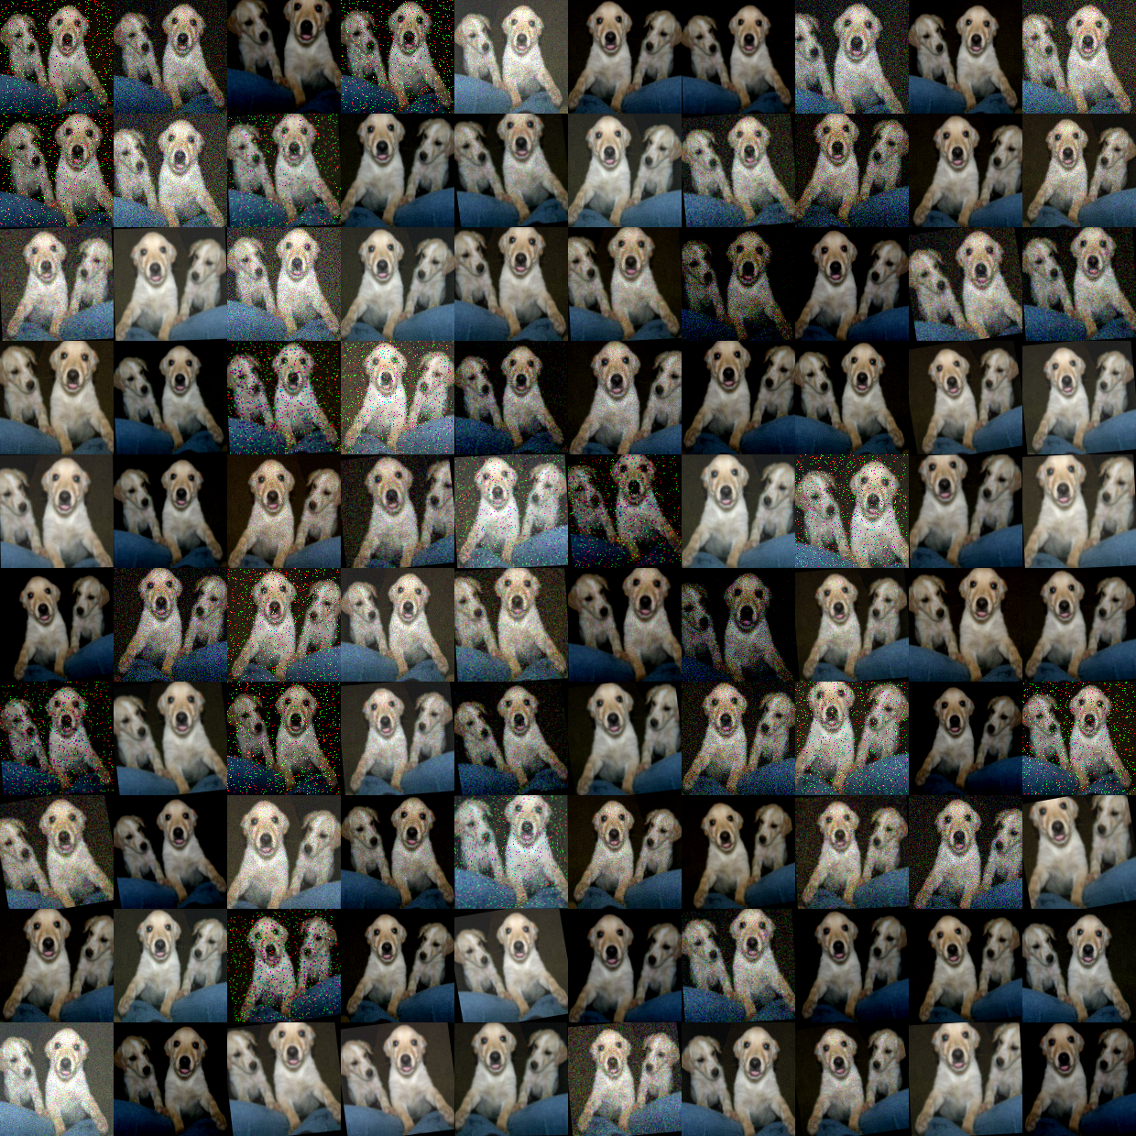
The Tuning Tricks
Deep Learning models perform incredibly well on the training data, so one of the big challenges is to make sure they are not overfitting and generalize well on the holdout sets.
Dropout: A bizarre method both developed by and denounced by the Hinton group that works well, essentially telling the model to randomly forget weights.
Batch Normalization: Between layers, subtracting the Batch mean and divide by Batch SD.
Data Augmentation: Morph the input image so that it essentially expands the dataset, giving the model more data to train on.

Slide 14
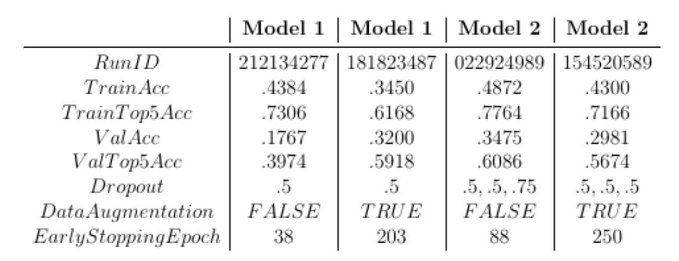
Results
In all, about 25 training and hyperparameter tuning jobs were submitted to CloudML.
The table shows four of the best overall performers trained over the TinyImageNet dataset. There were a few models not listed here that achieved > 90% top 5 accuracy on the training set, but were overfitting badly and did not generalize well, performing poorly on the validation dataset.
As a baseline for comparison, randomly guessing an image class from the TinyImagenet Dataset amounts to .5 top 1% accuracy, and 2.5% top 5 accuracy.
Overall, the more complex model (model 2) w/o data augmentation has the best performance metrics, but it is worth noting that there is a 16% difference in top 5 accuracy between the training and validation datasets indicative of overfitting. What may be preferred about this model is that the top 1 accuracy is also very high, indicating the model is generally identifying classes correctly.

Slide 15
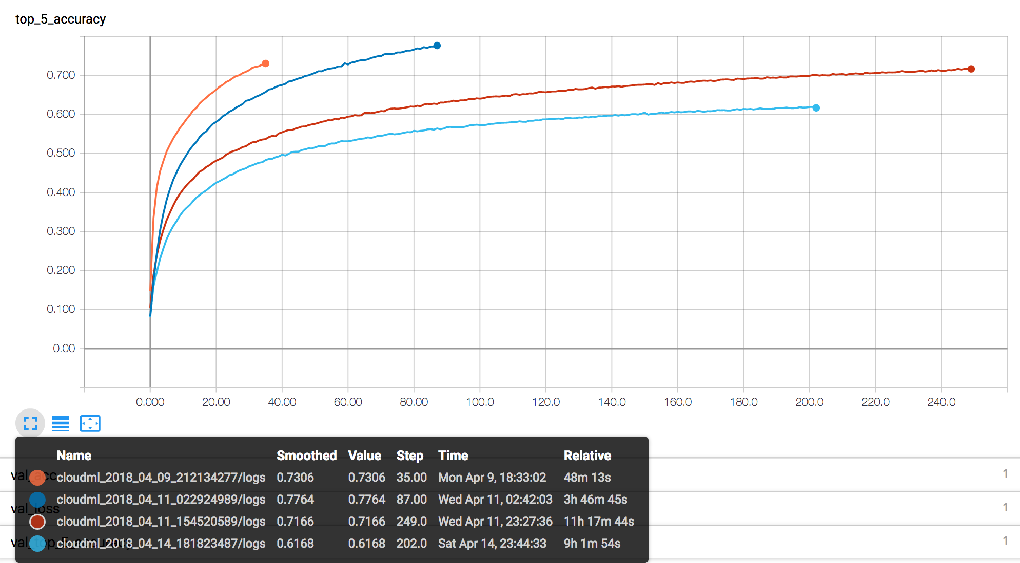
The Conclusion
Working with new open source tools to implement a Deep Learning CNN model for image classification, we were able to achieve a reasonable predictive classification accuracy.
Questions?

